Slide 1

Predicting the Difference in Goodreads Ratings and Amazon Ratings
By: Tien Nguyen & Tu Lam

Slide 2
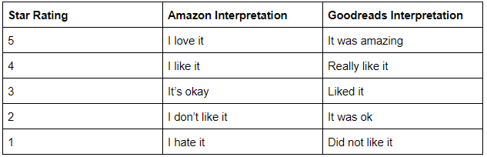
Project Objective
Motivation: Goodreads and Amazon are both well-established sources of book reviews. Should a user look at Goodreads or Amazon for book recommendations?
Problem: Goodreads and Amazon have different user base and different star rating interpretation
Differences in star rating interpretation between Amazon and Goodreads
Goal: Predict differences in ratings between Goodreads and Amazon so that users can have a better idea of a book’s ratings when comparing it between the two platforms

Slide 3
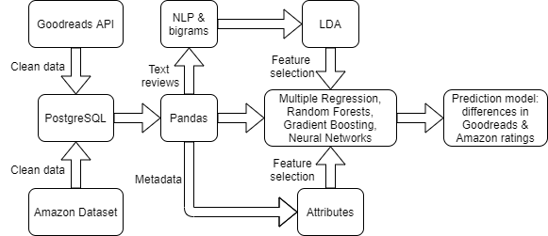
The Datasets

Slide 4
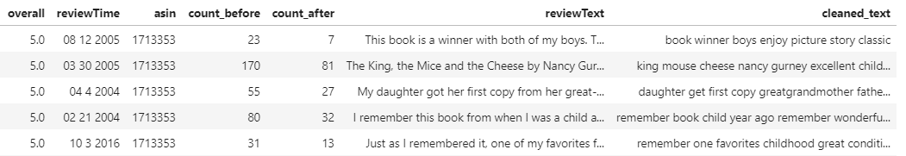
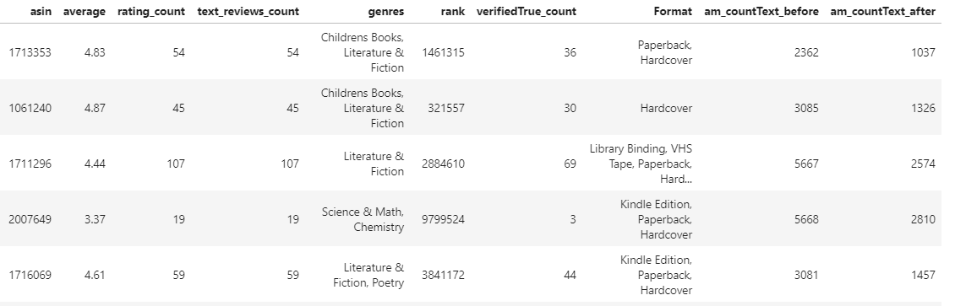
Amazon Datasets
Amazon reviews dataset : Amazon metadata dataset :
+ 5,683,680 reviews (rows) + 37,233 books
+ 6 features + 10 features
Amazon reviews dataset
Amazon metadata dataset

Slide 5
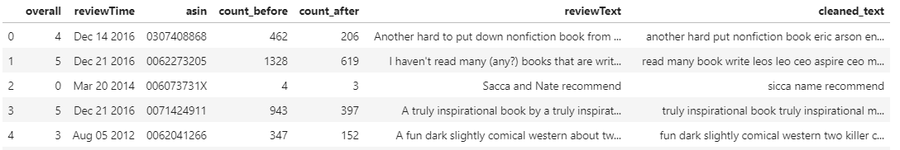
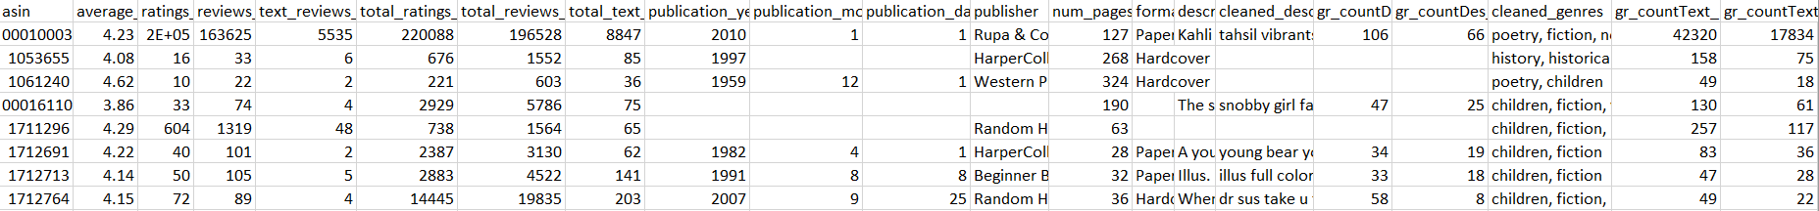
Goodreads Datasets
Goodreads reviews dataset: Goodreads metadata dataset:
+ 906,876 reviews + 37,233 books
+ 6 features + 21 features
Goodreads reviews dataset
Goodreads metadata dataset

Slide 6
Exploratory Data Analysis (EDA)

Slide 7
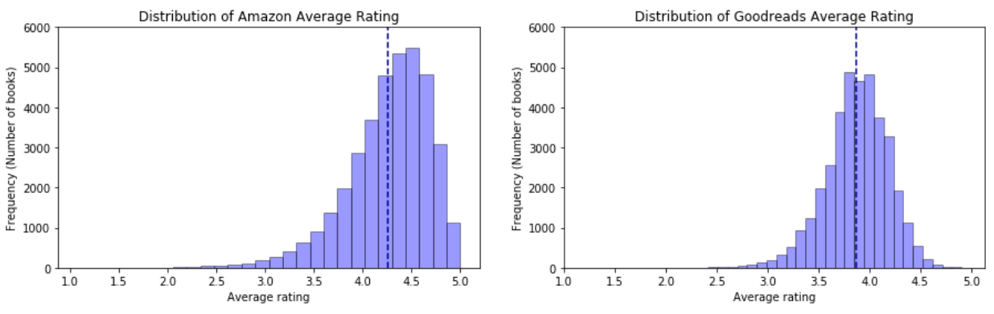

Slide 8
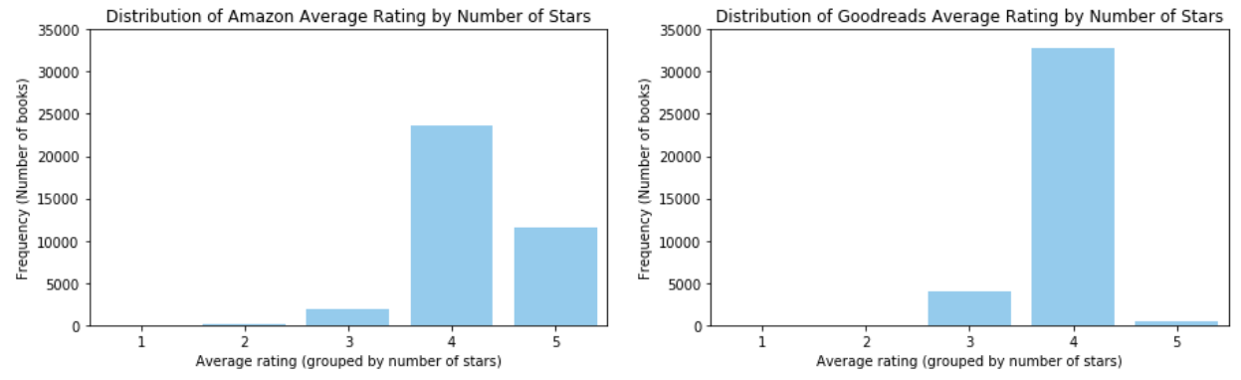

Slide 9
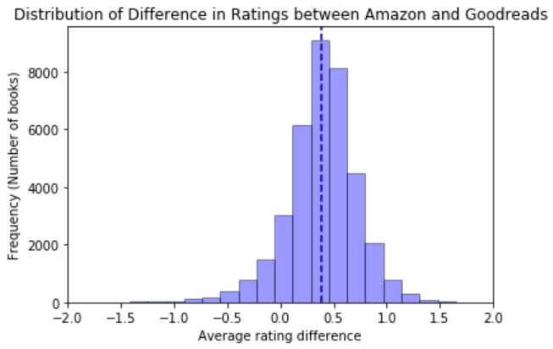
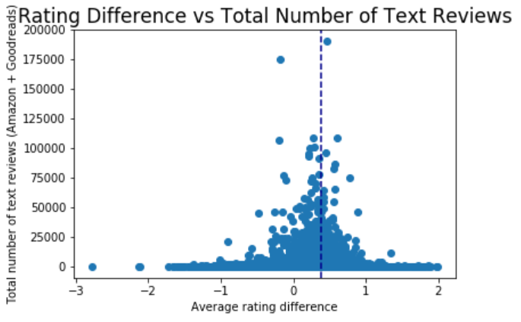

Slide 10
Data Modeling

Slide 11
Machine Learning Algorithms
Numeric and categorical data to predict
Multiple Regression
Assumptions:
Linearity ❌
Normality of the Error Terms ❌
No Autocorrelation of the Error Terms ✔️
Homoscedasticity ✔️
No Multicollinearity among Predictors ✔️
Random Forest
Can handle many predictor variables
Can handle skewed and multi-modal data
Can handle categorical data (e.g., one-hot encoding)
No formal assumptions
XgBoost
Can handle missing values
Can handle categorical data (e.g., one-hot encoding)
Accurate and fast (parallelization)
Neural Network
Doesn’t have assumptions about normality, linearity, variable independence, etc.
Can handle categorical data (e.g., one-hot encoding)
Can capture complex patterns in data
Evaluation : MAE, MSE, RMSE, and R2
Notes:
Due to violated assumptions, we decided not to use Multiple Regression.

Slide 12
Data Modeling (Basic Features)

Slide 13
Data Modeling (Basic Features)
Features selection
Numerical features
Ratings count, reviews count, rank, reviews word counts before/after cleaning, etc.
Data cleaning: combining columns
Null values: delete rows, replace w/ mean or median, impute?
Categorical features
Format, publisher, genres
One-hot encoding
Hyperparameters tuning using Grid Search Cross Validation

Slide 14
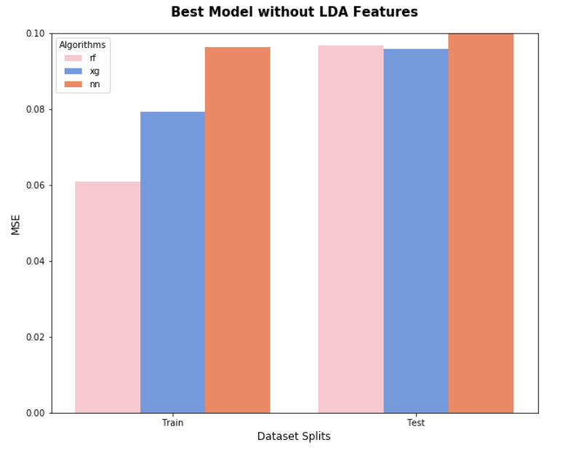
Data Modeling

Slide 15
Data Modeling (LDA)

Slide 16
Topic Modeling : Latent Dirichlet Allocation (LDA)
Gensim package
Mallet’s implementation (via Gensim)
Input : review texts of each book
Output : number of the proportion under each topic
Evaluate Topic Models : CV Coherence Score
Coherence Score : similarity between semantic meaning and statistically derived weights of the highest score words.
CV coherence score has the highest correlation between human ranked topic and its ranking.
Notes:
Note : Using gensim instead of scikit-learn. There is a bug in scikit-learn causing the perplexity to increase. Apparently that is the same for likelihood scores.
(https://github.com/scikit-learn/scikit-learn/issues/6777)

Slide 17
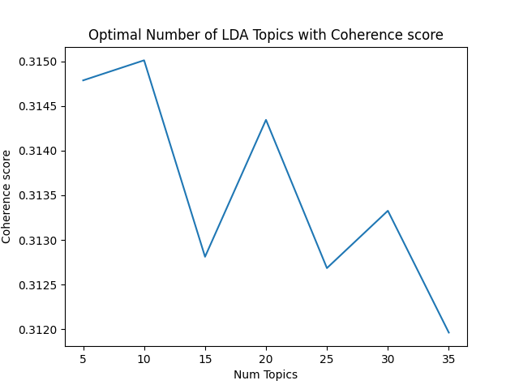
Optimal Number of Topics for LDA
Gensim’s inbuilt version of the LDA algorithm
Number of Topic : 10
Coherence Score : 0.315
Mallet’s LDA from within Gensim itself
Coherence Score : 0.337
Notes:
Just by changing the LDA algorithm, we increased the coherence score from 0.315 to 0.337

Slide 18
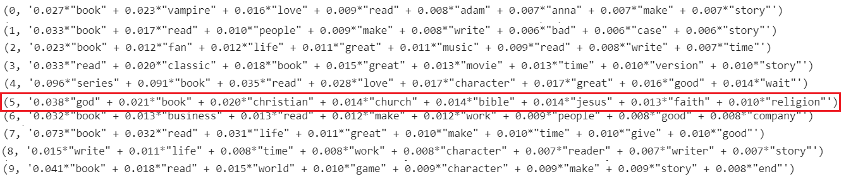
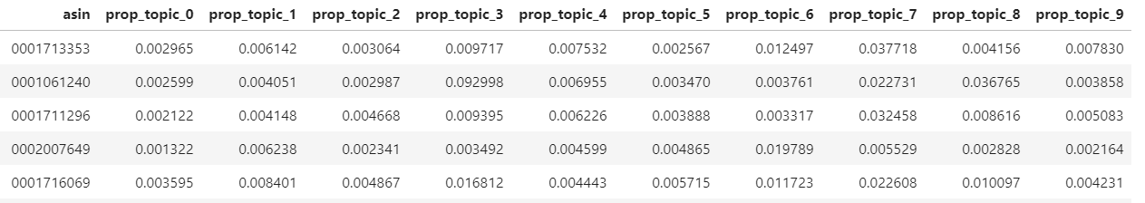
Topic Modeling (LDA) Continued
Dot product of weight and frequency words

Slide 19
Data Modeling (Prediction Models)
Combining Basic Features with LDA Features

Slide 20
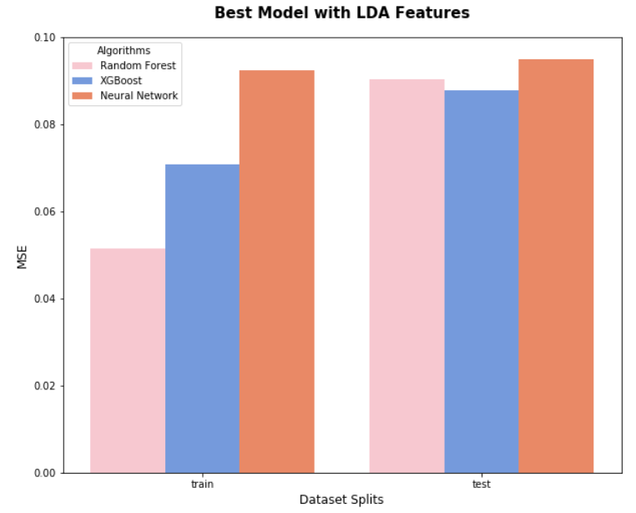
Data Modeling
Notes:
We split the dataset into training and testing set with the ratio 3 to 1. For training, the RF algorithm achieved the lowest MSE which is [...] while NN has the highest MSE which is [...]. For testing dataset, The MSE scores are similar across the three algorithms. And all of them are higher than the corresponding training MSE. We don’t think the RF algorithm is overfit here because the MSE difference between training and testing isn’t high. This indicates that cross validation is useful to test this hypothesis.

Slide 21
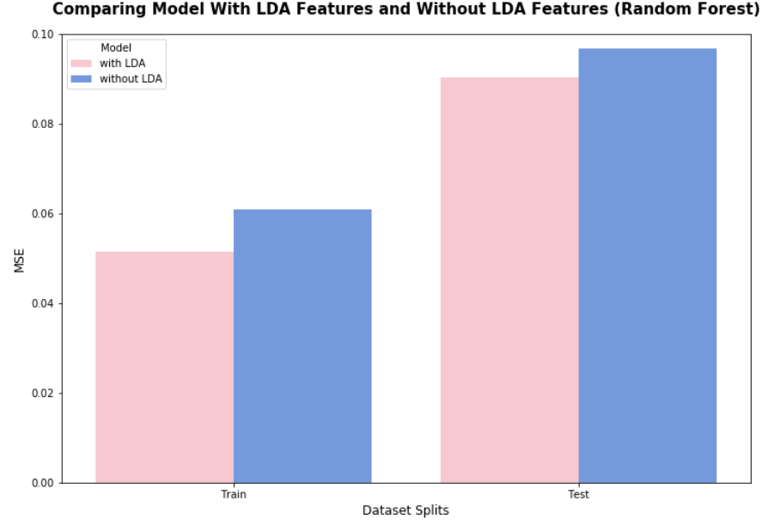
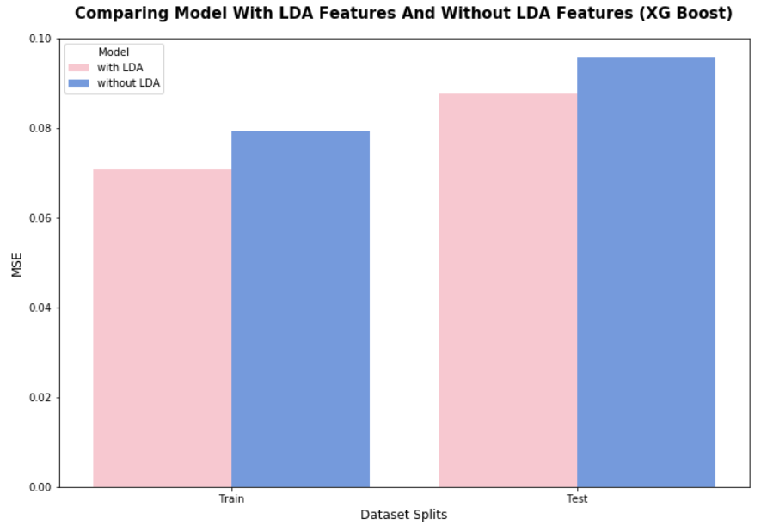
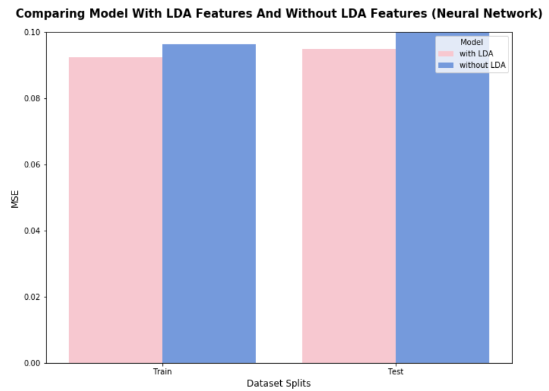
Data Modeling
Notes:
Feature inspection using a natural language processing technique such as LDA saw a generous decrease in predictor error.

Slide 22
Conclusion
The rating difference between Amazon and Goodreads, on average: 0.4
Our errors are small because the range of our prediction--difference in ratings between Goodreads and Amazon--is small (-4, 4)
Text review features play an important role.
Best models overall: Xgboost & Neural Network

Slide 23
Future Work
Combining Random Forest, Xgboost, and Neural Network algorithms into an ensemble to get better errors
Predict Amazon ratings based on features from Goodreads
LDA on Goodreads description
Predict Goodreads ratings based on features from Amazon
Compare various ratings difference prediction models (model using both Amazon and Goodread features, just Goodread features, or just Amazon features) and find the best one

Slide 24
QUESTIONS?
SUGGESTIONS?

Slide 25
